Slide 1
Communication
Rohan Samarajiva
66th Founder’s Day Oration, Thurstan College, 11 January 2016

Slide 2
Thurstan
The Founding Principal was Mr Earle Schokman, who had studied at Kingswood College, Kandy, where my father taught, and later taught at Trinity College
The Kandy influence can be seen in our colors, the same as those of Trinity
But different. Our motto is “තමසො මා ජ්‍යෝතිර්ගමය”
It did not have a primary school, it was Grade 6 (Year 7) and up
It was small; everyone knew everyone else
I entered Grade 6 in 1964 through the scholarship exam and left in 1971, after seven years of schooling in Middle School and College
Priya Paranavitane was a Head Prefect and Captain
Kumar Dewapura, a major figure in garment industry, was senior to me
Many contemporaries distinguished themselves in the armed forces
If not for my father, who passed away in 2012, and Mr Wijedasa, my maths teacher who also passed away around that time, I would not have spent seven years at Thurstan

Slide 3
Communication and our formation at Thurstan
One of my strong memories is speaking on “Perseverance” in English on this very stage when I was a student in Mrs Wijepala’s Grade 6 class
Both communication and perseverance have defined everything I have done since then
I cannot imagine that my College mates succeeded in leading men in battle lacking communication skills
Or that my College mates who redefined the industrial landscape of Sri Lanka did so without being effective communicators

Slide 4
But did we get all our communication skills from school?
My mother, an English teacher at Gothami Balika, coached me on public speaking
We all learned “on the job”
I was on the English and Sinhala debating teams at Law College but did not do debating at Thurstan
It was student politics at Peradeniya that prepared me
It was during the rag at Peradeniya that I truly understood the value of effective communication

Slide 5
But enough about me and the old days at Thurstan . . .
Let’s talk about communication

Slide 6
What is good communication?

Slide 7
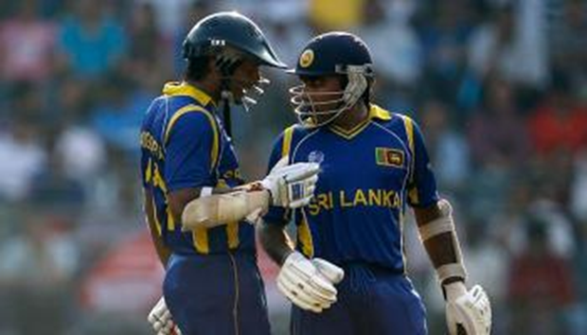
That was public. How about interpersonal? 624 run partnership not possible without good communication

Slide 8
And what are the outcomes of bad communication?
Senior Parliamentarians listening to 2016 Budget Speech
Luckily not delivered by a person associated with Thurstan
It’s a person from the school next door who said he did not pay attention at Sinhala class
But did he pay attention even in English class?

Slide 9
What are the key ingredients of effective communication?

Slide 10
What distinguishes humans from animals?
Tools?
Monkeys make tools. Even crows do

Slide 11
What distinguishes humans from animals?
Language?
Dolphins and whales have language
Perhaps even our beloved and mistreated elephants?

Slide 12
Story telling?
Not just Homo Erectus, but
Homo Narrans. The story-telling animal

Slide 13
So we should tell stories, well
Stories work across all formats
Television, the most powerful medium, is all about stories
Though our politicians still do not seem to get it
Radio appears to be reverting to its core function as a story-telling medium
My generation remembers Muvanpalassa
Internet is creating new opportunities for story telling
Blogs
Facebook
Even Twitter
But never forget the power of co-presence, like we are experiencing now

Slide 14
How do we tell good stories?
As Homo Narrans, we all have stories
But some stories are better than others
And some people are better at telling stories than others

Slide 15
A good story
Has a beginning, a middle and an end
Has a central theme, or a “moral”
The parts hang together; nothing is extraneous
Has suspense: Make listener want to know the ending
A problem or a puzzle that is solved
Helps if sex and/or violence are involved

Slide 16
A good story teller
Puts himself in the shoes of the audience
Empathy, the most important skill of all
The more one knows about the audience better the reception of the story
Includes listening (in interpersonal contexts)
Takes some risks, makes herself vulnerable

Slide 17
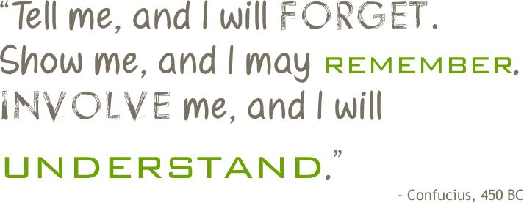
Anyone can be a good communicator

